Slide 1
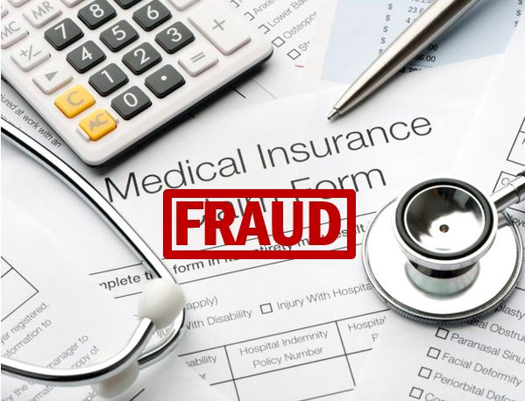
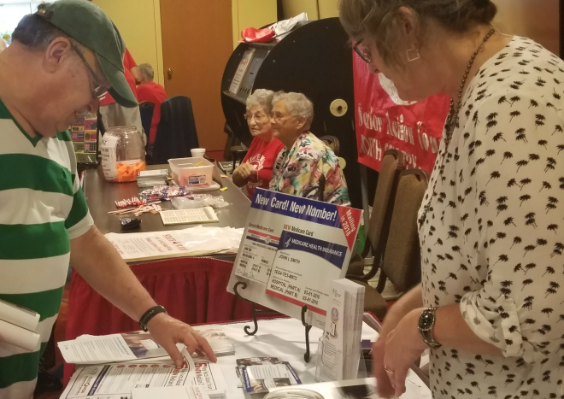
Take Charge… Help Prevent Health Care Fraud and Abuse!
NY StateWide Senior Action Council
Presented by: Betsy Mulvey, NY StateWide Senior Action Council

Slide 2
StateWide: Who We Are
2
New York StateWide Senior Action Council is a grassroots membership organization made up of individual senior citizens and senior citizen clubs, and organizations from all parts of New York State.
StateWide has a strong history providing outreach and education to senior citizens and their families since 1972
StateWide is the only organization in New York State that is governed and directed by seniors and that advocates for seniors on a grassroots level.

Slide 3
StateWide Programs
3
Patient’s Rights Helpline
Toll free number to assist hospitalized and institutionalized patients and their families with their rights.
MCCAP (Managed Care Counseling & Assistance Program)
To inform, educate and assist seniors and their families in making the best and most informed decisions regarding their healthcare in NYS.

Slide 4
Programs
4
Elder Economic Security Index - StateWide is the leading agency in NYS for the Elderly Economic Security Index. We partner with the National Coalition on Aging and the Gerontology Institute of the University of Massachusetts.
The index calculates the average cost of living for NY elders to remain living in the community.
The index is a powerful tool when we advocate for programs that preserve the quality of life for seniors.
4

Slide 5
Programs
5
And the Senior Medicare Patrol (SMP), our newest program
800-333-4374
www.nysenior.org
5

Slide 6
Medicare Fraud and Abuse
6

Slide 7
Overview
7
Medicare Fraud, Errors and Abuse Affect…
Everyone
Billions of taxpayer dollars lost to improper claims
Medicare trust fund at risk
Medicare Beneficiaries
Higher premiums
Less money for needed benefits
Quality of treatment
Notes:
Suggested audience interaction to introduce this slide – ask the audience:
How many of you are Medicare beneficiaries? (raise hands)
How many of you are caregivers? (raise hands)
How many of you pay taxes? (raise hands)
You might be wondering, why should I care about Medicare fraud? Well, Medicare fraud, errors, and abuse affect everyone!
Each year, Medicare loses BILLIONS of taxpayer dollars to improper claims.
This puts the Medicare trust fund at risk for everyone and affects the future of the Medicare program.
Medicare fraud, errors, and abuse also affect current Medicare beneficiaries because they result in higher Medicare premiums and waste money that could be used to increase and improve health care services.

Slide 8
Consequences
8
Medical Identity Theft
Health Impact
19%
19%
20%
21%
22%
24%
24%
25%
26%
Personal Financial Losses
19%
19%
20%
21%
22%
24%
24%
25%
26%
Notes:
Medicare fraud, errors, and abuse can also cause serious personal consequences for beneficiaries, such as medical identity theft, negative health impacts, and personal financial losses.
Medical Identity Theft
Medical identity theft occurs when a beneficiary’s Medicare number is misused, either by a provider, a supplier, or by someone posing as the real beneficiary in order to receive medical care. Such Medicare numbers are considered “compromised.” Medicare numbers are for life, even if stolen or misused, so a beneficiary whose number is compromised may be affected forever by false claims against his or her Medicare number.
Health Impact
Receiving health care from a fraudulent provider can mean the quality of the care is poor, the intervention is not medically necessary, or worse: The intervention is actually harmful. A beneficiary may later receive improper medical treatment from legitimate providers as a result of inaccurate medical records that contain:
False diagnoses
Records showing treatments that never occurred
Misinformation about allergies
Incorrect lab results
Additionally, because of inaccurate or fraudulent claims to Medicare, beneficiaries may be denied needed Medicare benefits. For example, some products and services have limits. If Medicare thinks such products and services were already provided, they will deny payment.
Personal Financial Losses
Medicare fraud, errors, and abuse can all result in higher out-of-pocket costs for beneficiaries, such as copayments for health care services that were never provided, were excessive, or were medically unnecessary. Beneficiaries may also find themselves stuck with bills for services from providers who should have billed Medicare but instead billed the beneficiary for the entire cost of that service. Finally, because Medicare numbers also contain Social Security numbers, financial fraud can be a side effect of having one’s Medicare number compromised. Medicare numbers are as valuable as Social Security numbers to thieves who wish to set up credit card accounts with someone else’s identity.
Also, there may be legal consequences for beneficiaries who are complicit in fraud and abuse, since participating in schemes to defraud Medicare is illegal!

Slide 9
Senior Medicare Patrol (SMP)
9
What is the Senior Medicare Patrol?
SMPs
Help Medicare beneficiaries prevent, detect, and report health care fraud
Help preserve the integrity of the Medicare program
Rely on volunteers to help perform SMP work
Notes:
The Senior Medicare Patrol is here to help you avoid these problems.
Senior Medicare Patrol programs, or SMPs, help Medicare and Medicaid beneficiaries prevent, detect, and report health care fraud. By doing so, we help preserve the integrity of the Medicare and Medicaid programs. Because this work often requires face-to-face contact to be most effective, SMPs nationwide rely on approximately 5,000 volunteers who are active each year to help in this effort.
Suggested Handout: SMP Brochure (available in multiple languages)
www.smpresource.org > Resources for SMPs > SMP Resource Library

Slide 10
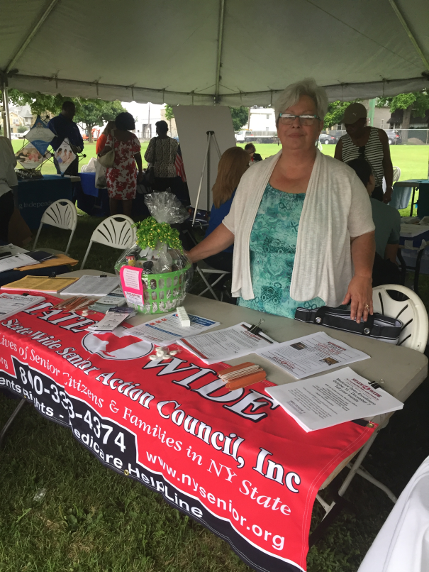
Senior Medicare Patrol Mission
10
The SMP mission is…
To empower and assist Medicare beneficiaries, their families, and caregivers
to prevent, detect, and report health care fraud, errors, and abuse
through outreach, counseling, and education.
StateWide Counselor Beth Nelson
Notes:
Education and prevention are at the core of the Senior Medicare Patrol program, as demonstrated by its mission: (read the slide)

Slide 11
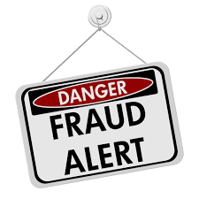
Medicare Fraud
11
What is Medicare Fraud?
Intentionally billing Medicare for services that were not received or billing for a service at a higher rate than is actually justified
Notes:
Medicare fraud involves intentionally billing Medicare for services that were not received, or billing for a service at a higher rate than is actually justified.

Slide 12
Medicare Abuse
12
What is Medicare Abuse?
Providers supply services or products that are not medically necessary or that do not meet professional standards
Notes:
Next, what is Medicare abuse?
Medicare abuse occurs when providers supply services or products that are not medically necessary or that do not meet professional standards. Medicare fraud and abuse are very similar and many times overlap.

Slide 13
Examples of Medicare Fraud
13
Billing for services, supplies, or equipment that were not provided
Billing for excessive medical supplies
Obtaining or giving a Medicare number for “free” services
Improper coding to obtain a higher payment
Unneeded or excessive x‐rays and lab tests
Claims for services that are not medically necessary
Using another person’s Medicare number, or letting someone else use your number
Notes:
Here are some examples of fraud and abuse:
Billing for services, supplies, or equipment that were not provided
Billing for excessive medical supplies
Obtaining or giving Medicare number for “free” services; treat any offer of free services in exchange for your Medicare or health care identification number with caution
Improper coding to obtain a higher payment
Unneeded or excessive x‐rays and lab tests
Claims for services that are not medically necessary
Using another person’s Medicare number, or letting someone else use your number, to obtain medical care, supplies, or equipment

Slide 14
What Can YOU Do?
14

Slide 15
3 Steps to Prevent Fraud
15
So, what can YOU do to take charge and help prevent Medicare fraud, errors, and abuse?
I am here to tell you how in three easy steps:
PROTECT
DETECT
REPORT
Notes:
So, what can YOU do to take charge and help prevent Medicare fraud, errors, and abuse? I am here to tell you how in three easy steps: protect, detect, and report.

Slide 16
Protect Yourself and Others from Medicare Fraud
Step 1
16
DO
DON’T
Treat your Medicare card and number like your credit card.
Watch out for identity theft.
Be aware that Medicare doesn’t call or visit to sell you anything.
Be cautious of offers for “free” medical services.
PASS IT ON!
Don't give out your Medicare number except to your doctor or other Medicare provider.
Don’t carry your Medicare card unless you will need it.
Notes:
First, protect yourself and your loved ones from Medicare fraud and abuse!
Do treat your Medicare and Social Security cards and numbers like your credit card. Don't give out your Medicare number except to your doctor or other Medicare provider. Don’t carry your Medicare card unless you will need it. Only take it to doctors’ appointments, visits to your hospital or clinic, or trips to the pharmacy.
Do watch out for identity theft. Scam artists will not only use your Medicare number to defraud the Medicare system, but this is also one way that people can steal your identity, since your Social Security number is typically included in your Medicare number!
Do be aware that Medicare doesn’t call or visit to sell you anything. However, Medicare does now require their contractors to contact beneficiaries from time to time, so make sure to be vigilant. Keep in mind that you don’t have to talk to anyone who calls you or shows up at your door who you do not trust…Medicare contractors will understand.
Do be cautious of offers for “free” medical services. If it sounds too good to be true, it probably is!
Do pass it on! Share this information with friends and family members who might not already know how to prevent Medicare fraud and abuse.

Slide 17
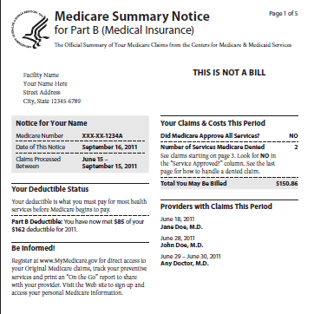
Step 2
17
Detect Medicare Fraud & Abuse
Use your Personal Health Care Journal
Review Medicare Summary Notices (MSNs) and other statements for: 1. Services you didn’t receive 2. Double-billing 3. Services not ordered by your doctor
Access your Medicare information at www.MyMedicare.gov.
Notes:
Second, detect Medicare fraud and abuse. Even when you do everything right, there is a chance that you could be a target of health care fraud. There are many ways that your personal information can be used without your permission.
Record doctor visits, tests and procedures in your personal health care journal or calendar.
Always review your Medicare Summary Notice and Explanation of Benefits for mistakes.
Look for three things on your billing statements:
Charges for something you didn’t receive
Billing for the same thing twice, and
Services that were not ordered by your doctor
Compare your Medicare Summary Notices and other statements to your personal health care journal and prescription drug receipts to make sure they are correct.
Access to your current Medicare account is available 24 hours a day at www.MyMedicare.gov.
Suggested Handouts: MSN Fact Sheet and Personal Health Care Journal
Available in multiple languages at www.smpresource.org > Resources for SMPs > SMP Resource Library
Tip: If you have time, hand out the MSN Fact Sheet and/or Personal Health Care Journal (PHCJ) and review with the group. Explain how to use your MSN to detect fraud, errors, and abuse, and review the information to look for in each type of statement. Point out the instructions in the front of the PHCJ and explain how to use it to track health care visits and what types of questions to consider at each appointment.

Slide 18
Step 3
18
Report Suspected Medicare Fraud and Abuse
Call the provider.
Gather information and documentation.
Contact the NYS SMP.
This is a free and confidential service!
NYS SMP Phone Number 800-333-4374
Notes:
Third, if you detect or suspect fraud or abuse, report it. You will protect other people from becoming victims and help to save your Medicare benefits. Here are the steps you should take to report your concerns:
First, if you have questions about information on your Medicare Summary Notice (known as your MSN) or Explanation of Benefits (called an EOB), call your provider or plan to find out if it was an error that they can correct without taking any further action.
If you are not satisfied with the response you get or are not comfortable calling your provider or plan, gather all of the facts that you can about your situation.
Make sure you have your MSN or EOB and any other supporting documentation that shows the possible fraud or abuse.
Then, contact your SMP if you need help.
Please keep in mind that services provided by your SMP are free and confidential.

Slide 19
3 Step Review
19
PROTECT
DETECT
REPORT
3 Steps to Prevent Healthcare Fraud
Notes:
Remember how YOU can take charge and help prevent Medicare fraud, errors, and abuse in three easy steps: protect, detect, and report! And remember to take what you know and “pass it on” to friends and loved ones who might not be as familiar with this information.

Slide 20
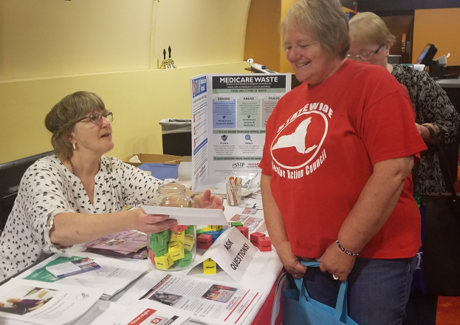
Volunteer
20
Join the SMP Program, Become a Volunteer Today!
Help Medicare Beneficiaries Protect, Detect, and Report
Give
Presentations
(like this one!)
Provide
One-on-one
Counseling
Perform Administrative Work
Call 800-333-4374
Notes:
Now that you have learned how to prevent, detect, and report Medicare fraud, errors, and abuse, would you like to help other Medicare beneficiaries do so too? SMP volunteers, like ME, give group presentations like this one, provide individual counseling to beneficiaries, perform administrative work, and more! If you would like to join the SMP program as a volunteer, please talk with me after this presentation or contact the local SMP.

Slide 21
Contact Us
21
Contact your State SMP: New York StateWide Senior Action Council
Visit us online: (www.nysenior.org)
For more information
Call Toll-free: (800-333-4374)
To report suspected fraud/abuse
For training, speakers, and/or materials
To volunteer with the SMP program

Slide 22
Questions
22
Any Questions?
Notes:
If any of you have questions, please ask them now or feel free to talk to me after the presentation.
Answer questions or have your partner agency answer questions, as applicable; see the SMP Group Education Training Manual and/or SMP Counselor Training Manual for guidance during the Q&A session.
I hope today’s presentation has been useful in showing you how to take action to prevent Medicare fraud and abuse by taking three important steps.
Protect your Medicare number,
Detect fraud, errors, and abuse by reviewing your Medicare Summary Notices, and
Report any potential issues to your SMP.
Thank you for your time and for participating in this session!

Slide 23
23
This project was supported, in part by grant number 90MPPG0010-01-00, from the U.S. Administration for Community Living, Department of Health and Human Services, Washington, D.C. 20201. Grantees undertaking projects under government sponsorship are encouraged to express freely their findings and conclusions. Points of view or opinions do not, therefore, necessarily represent official Administration for Community Living policy.
Notes:
If any of you have questions, please ask them now or feel free to talk to me after the presentation.
Answer questions or have your partner agency answer questions, as applicable; see the SMP Group Education Training Manual and/or SMP Counselor Training Manual for guidance during the Q&A session.
I hope today’s presentation has been useful in showing you how to take action to prevent Medicare fraud and abuse by taking three important steps.
Protect your Medicare number,
Detect fraud, errors, and abuse by reviewing your Medicare Summary Notices, and
Report any potential issues to your SMP.
Thank you for your time and for participating in this session!

